Slide 1
Making Scores Comparable: Test Equating
Derek Briggs
EDUC 8720

Slide 2
Activity
Researchers were interested in evaluating a new science curriculum. They developed two test forms intended to measure students’ understanding of the concepts covered in the curriculum, “Form A” and “Form B”. The maximum possible total score on both test forms was 40 points.
During an initial pilot test, researchers had 10 students take both test forms. The scores that students received on each test form are in the file “equating_example.xlsx”. It was clear that the two test forms are not equally difficult.
One additional student also participated in the pilot study, but had to leave early. Josh only took Form A and received a score of 20 points. Answer the following:
Which test form was more difficult?
What score would Josh have earned on Form B?
If a student scored a 34 on Form B, do you think they know more about the tested content than Josh?
Please spend 10 minutes trying to answer these three questions on your own, then spend another 10 minutes discussing in your small group. Hint: there are three different methods you could use to answer question 2.

Slide 3
Outline
Background
Equating Designs
Analytical Methods
Observed Score Equating
Mean, Linear, Equipercentile
IRT Equating
Separate: Mean/Sigma, Stocking-Lord
Concurrent Calibration
The benefit (and cost) of “pre-equating”

Slide 4
Background

Slide 5
Why link and equate tests?
Comparing scores on different tests
ACT/SAT concordance tables
SEDA maps
Using multiple tests forms
Avoid outright cheating or item exposure
Pre/post designs
Allow for gradual changes in test design?

Slide 6
Equating vs. Linking (Holland & Dorans, 2006)
linking
“For two tests, a link between their scores is a transformation from a score on one to a score on the other. . . We use the term linking to refer to the general idea of a transformation between the scores from one test and those of another. . . we will divide linking methods in three basic categories called predicting, scale aligning, and equating” (p. 187).
equating
“In test equating a direct link is made between a score on one test and a score on another test. The purpose of equating tests is to allow the scores from each test to be used interchangeably, as if they had come from the same test” (p. 193).

Slide 7
A Test Linking Framework
Source: Holland & Dorans (2006)

Slide 8
Holland & Dorans Terminology
"Linking" refers to the general process of trying to map scores on one test to another, for various purposes.
"Equating" is a special kind of linking done to make scores on two or more tests completely interchangeable. Thus, equating has additional requirements beyond other forms of linking.
types of linking (Holland and Dorans, 2006)
Battery scaling: different constructs and common population
Vertical scaling: similar constructs/reliability, different populations and difficulty
Calibration: same construct and population, but different reliability
Concordances: similar constructs/difficulty/reliability and same population

Slide 9
Test Equating Requirements
Equating is the strongest form of test linking. Has 5 requirements:
Construct Invariance – Equated tests must measure the same construct
Equal Reliability – Tests must be equally reliable
Symmetry – The equation to transform scores from X to Y should be the inverse of the equation for the transformation from Y to X
Equity – It should be a matter of indifference as to which test an individual takes
Population Invariance – The estimation of parameters for use in the equating function should not depend on the selected (sub) population

Slide 10
Sources of Confusion
It is common for people to use the term “calibration” to refer to the process of estimating the item and person parameters of an IRT model.
Vertical scaling or vertical equating?
How does one tell if constructs are different or similar?
Given that the 5 requirements for a true equating of tests will almost never be met, could argue that the most salient distinction is between methods of prediction vs methods for scaling/equating.
In what follows the focus is on designs and analyses for test equating, but they also generally apply to contexts for “scale aligning”

Slide 11
Disclaimer
Statistically, we can link or equate almost anything. For example, we could apply linking or equating methods to weight and scores on a reading test, or to miles driven last year and number of words on your Facebook profile. Context and interpretation are required to assess whether a linking or equating is reasonable and meaningful, or just statistical nonesense.

Slide 12
Designs

Slide 13
Fundamental Challenge
Say we have two forms of a test, A and B, with at least some unique items on each form
How do we disentangle differences in the difficulty of the items on tests A and B from differences in the ability of the two groups of test-takers?
At heart, the key question is always about a counterfactual inference: We observe a score for student X on test A. How would the same student have scored if given test B instead?

Slide 14
Equating/Linking Designs
single group design
All participants take both tests X and Y. Sometimes we are concerned about order effects - examinees might do worse on the second test. Hence order of X and Y is usually counterbalanced, with half examinees randomly chose to take X first and half take Y first.
equivalent groups design
Randomly assign each participant either form X or form Y. We assume that the random assignment ensures that the group taking X is equivalent in every way to the group taking Y.
NEAT design (Non-Equivalent groups with Anchor Test)
(also sometimes called “Common Item Non-Equivalent Groups” Design)
Some examinees take test X and some take test Y (without random assignment) but all examinees also take the anchor “test” A (where A might actually be a subset of items common to both X and Y).

Slide 15
Equating/Linking Designs
1. Equivalent Groups Design
Population | Sample | X | Y
P | 1 | *
P | 2 |  | *
2. Counterbalanced Design with Equivalent Groups
Population | Sample | X₁ | Y₁ | X₂ | Y₂
P | 1 | * |  |  | *
P | 2 |  | * | *
3. Common Item Design with Nonequivalent Groups (aka “NEAT” Design)
Population | Sample | X | A | Y
P | 1 | * | *
Q | 2 |  | * | *

Slide 16
Test Equating without IRT

Slide 17
Observed Score Equating for Single or Equivalent Groups Designs
Mean Score Equating. Assumes two score distributions differ primarily by their mean.
Linear Equating. Assumes two score distributions differ primarly by mean and variance.
Equipercentile Equating. Assumes two score distributions differ with respect to mean, variance, skewness, kurtosis…

Slide 18
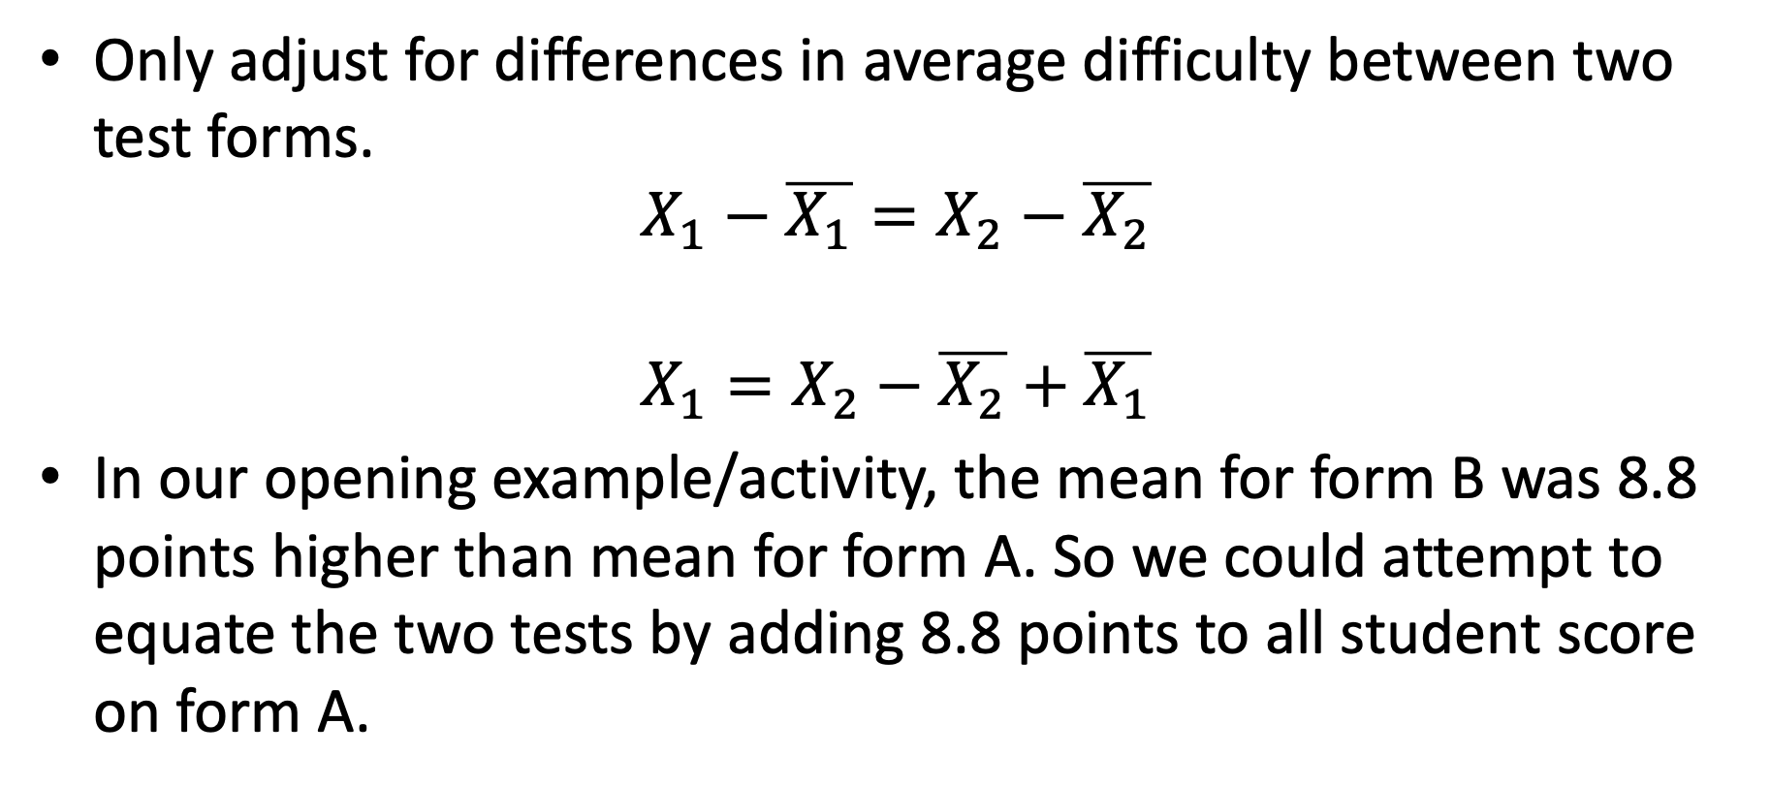
(1) Mean Equating
Only adjust for differences in average difficulty between two test forms.
$$X_{1}−\overline{X_{1}}=X_{2}−\overline{X_{2}}$$
$$X_{1}=X_{2}−\overline{X_{2}}+\overline{X_{1}}$$
In our opening example/activity, the mean for form B was 8.8 points higher than mean for form A. So we could attempt to equate the two tests by adding 8.8 points to all student score on form A.

Slide 19
(2) Linear Equating
To equate scores on a new form (X) to scores on a reference form (Y) for a group of test-takers from the same population, transform each score on the new form to the score on the reference form that is the same number of standard deviations above or below the mean of the reference group. (Livingston, 2004)

Slide 20
Linear Equating in Action
Solve for Y (score that would be observed on reference form) in terms of X (score observed on new form). This gives us a value for X that is adjusted relative to Y.
Linking Constants:
“A”
“B”

Slide 21
(3) Equipercentile Equating
To equate scores on the new form to scores on the reference form in a group of test-takers, transform each score on the new form to the score on the reference form that has the same percentile rank in that group.
Steps:
Find the percentile rank for a score on new form
Find the inverse of that percentile rank to get the corresponding score on a reference form.

Slide 22
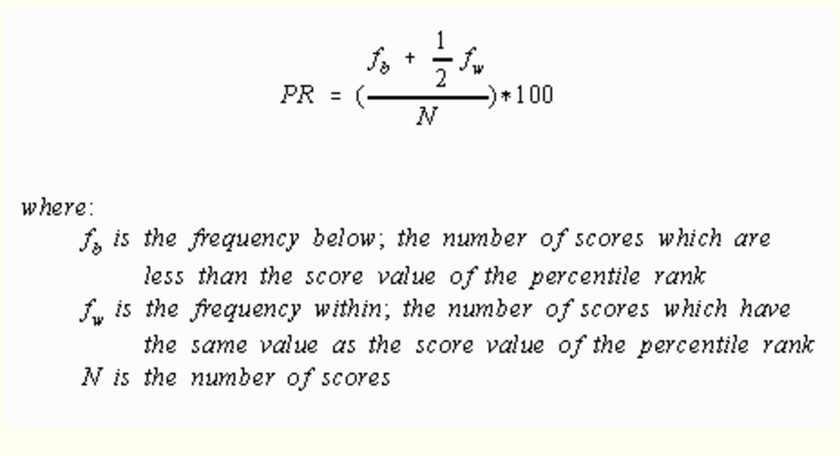
Percentile Ranks

Slide 23
Challenges with Equipercentile Equating
Since equipercentile equating makes the fewest assumptions, why not always do this?
Because the equipercentile approach implicitly assumes we have two continuous variables.
But raw test scores are discrete
So we need to “continuize” test scores to make this work
In addition, if we have two relatively small samples of student from target populations, distributions might be choppy due because some total scores may be infrequently observed
“Smoothing” is often done on the two score distributions before they are equated.

Slide 24
More General Problem
Creating a score scale that is distinct from raw score points on a test
Grain size of the scale?
Truncation at top and bottom?
Rounding to nearest integer?

Slide 25
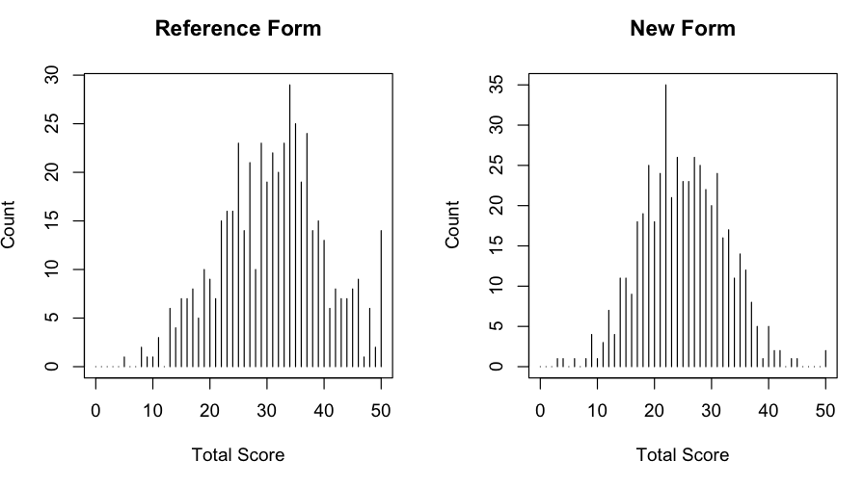
Example: An Initial Graphical Comparison

Slide 26
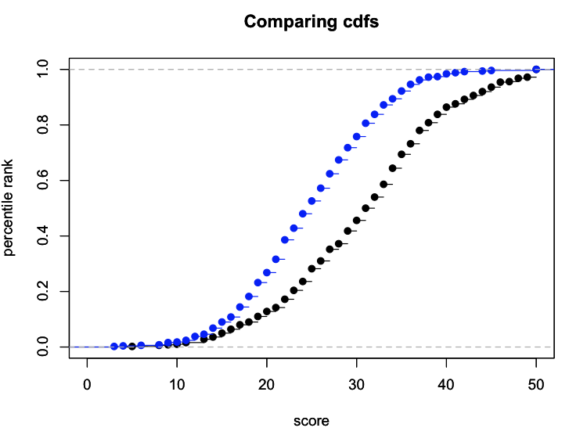
Comparing CDFs

Slide 27
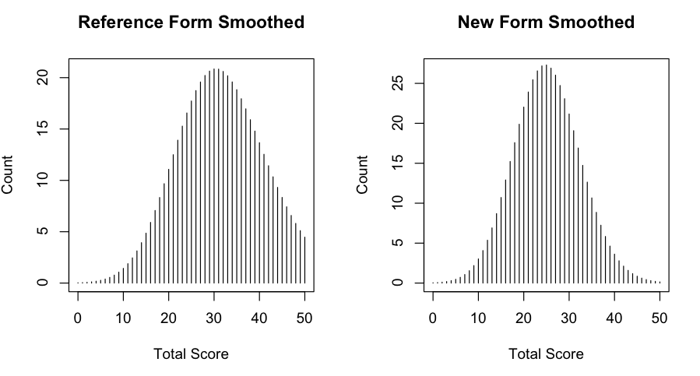
After Smoothing the Score Distributions

Slide 28
Methods of Observed Score Equating for NEAT Design
Chained Linear Equating
Chained Equipercentile Equating
Frequency Distribution Equating
Tucker Equating
Levine Equating
For more on these methods, see Livingston (2004) or Kolen & Brennan (2014).

Slide 29
Choosing Common Items for “Anchor Test”
Mini-test criterion (item should represent the same content as the test on the whole)
At least 20% of total items (but it is really the number that matters here, 20% of short test will likely be insufficient)
Should vary in difficulty
Same location on test—beware context effects!
Keep together with collection in common prompt.

Slide 30
Doing Observed Score Equating in R
Albano, A. D. (2016). equate: An R package for observed-score linking and equating. Journal of Statistical Software, 74(8), 1–36.
You really don’t need this package if you are just doing mean or linear observed score equating—all you need are the means of SDs of two test forms to be equated…provided you have implemented a single or equivalent groups design.
But equipercentile equating is a lot more complicated, and this package provides a lot of nice options for doing this.

Slide 31
Test Equating with IRT

Slide 32
Three Approaches
Separate Calibration (sometimes called “post-equating”)
Concurrent Calibration
Anchored Calibration (also known as “pre-equating”)

Slide 33
The Basic Idea
In IRT equating we need to find a way to put the item parameters from different test forms onto the same scale. Once this is done, we can use these item parameters to estimate theta in various ways, and all of the theta estimates should be directly comparable.
Linking with IRT relies on the property of parameter invariance. The implication of this property (if the IRT model shows adequate fit to the data) is that item parameters estimated in any population/sample should be the same up to a linear transformation (meaning they should be perfectly correlated).

Slide 34
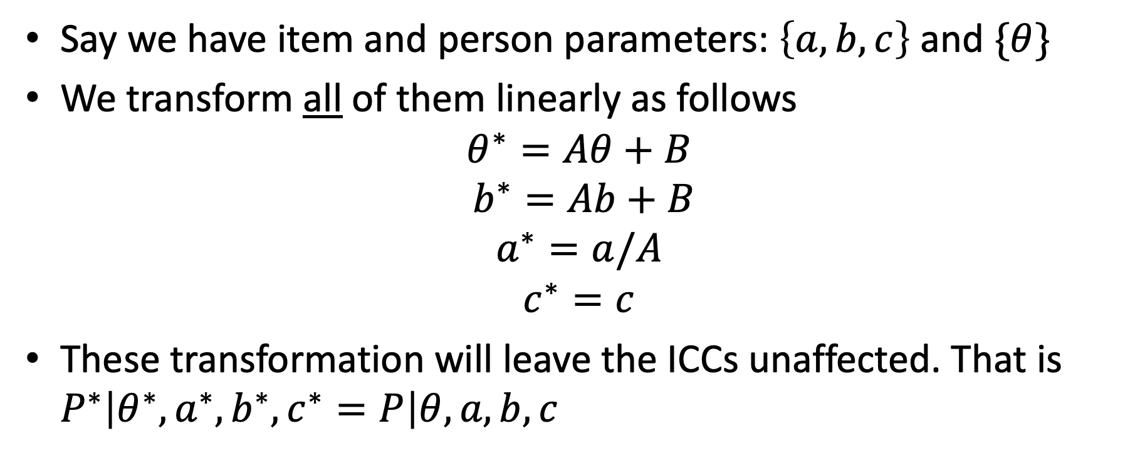
“Up to a Linear Transformation”
Say we have item and person parameters: $\left\{a,b,c\right\}$ and $\{θ\}$
We transform all of them linearly as follows
$$θ^{∗}=Aθ+B$$
$$b^{∗}=Ab+B$$
$$a^{∗}=a/A$$
$$c^{∗}=c$$
These transformation will leave the ICCs unaffected. That is $P^{∗}\left|θ^{∗},a^{∗},b^{∗}, c^{∗}=P\right|θ,a,b,c$

Slide 35
Impact of Scale Identification Constraints on Item Parameter Estimates
We usually identify the scale of an IRT model by assuming θ ~ N(0,1). All of the item parameters are estimated relative to this scale. Imagine a moderately difficult item. If we estimate item parameters in a sample with high ability, the b value for the item will probably be slightly negative - in this sample, someone slightly below the mean has a 50% chance of answering it correctly. But, if we estimate item parameters in a low ability sample, the b value will probably be positive and possibly large, since only people well above the mean in this sample have a 50% chance of answering the item correctly. This is not a violation of parameter invariance. It happens because the item parameter estimates are on a scale relative to the sample being used. But all other item parameters will shift up or down in unison, so that estimates from both samples are perfectly correlated. A violation of parameter invariance would occur if some items shifted by more/less than other items.

Slide 36
Ramifications When Using a NEAT Design with IRT
Say we calibrate our IRT model separately for nonequivalent groups taking two test forms with a subset of common items.
Now, if the two groups were equivalent, we expect to get the same item parameter estimates.
If they are not the same, part of the reason could be that the groups are non-equivalent (but also possible we have DIF or estimation error).
If it’s just because the two groups differ in ability distributions, we should be able to equate the parameters for the common items using a linear transformation.
The challenge is to estimate the “linking constants” (A and B)

Slide 37
Separate Calibration with NEAT Design
Leveraging the property of parameter invariance.
If the model fits the data, then item parameter estimates should be the same regardless of the group used to estimate them.
So the idea is this—any difference observed in parameters for common items must be an artifact of the way the scale was anchored (i.e., forcing two different groups of students to have same mean and SD of ability)
The item parameters should be linearly related.
So we establish the link between tests on basis of common items and then extrapolate to unique items to place all items on same scale.

Slide 38
IRT Linking Equations
If parameters for each of two test forms are estimated separately, a linear transformation is used to place the parameters from one test—the “From” scale (F)—onto the scale of the other—the “To” scale (T).
Ability Estimates
Item Parameters
discrimination
difficulty

Slide 39
Estimating Linking Constant: Moment Methods
Mean/Sigma Approach
Mean/Mean Approach
The means and SDs are computed for the common items only (even if difficulty and discrimination parameters have been estimated for both common and unique items in the ”From” and “To” forms)

Slide 40
Characteristic Curve Method
Stocking & Lord (1983)
where (under the 3PL model)

Slide 41
For either the ICCs or the TCCs
For given values of θ, take the difference between the response probabilities
Square the differences
Sum the squared differences across all theta values
Find the linking constants A and B that minimize these differences
To
From

Slide 42
Concurrent Calibration
Say we administer two different test forms under either a single group or equivalent group design.
In the world of IRT, all we need to do is a concurrent calibration of both test forms and all the unique items contained on the two forms will be on the same scale.
Say we administer two different forms under a NEAT design
We can still just do a concurrent calibration with data in our response matrix that is missing by design, but we need to take into account that there are two different populations. Known as a “multi-group” IRT calibration.
In mirt, can see https://philchalmers.github.io/mirt/html/multipleGroup.html

Slide 43
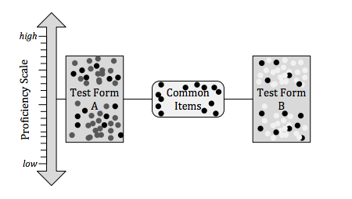
Common Item Linking in IRT (Separate or Concurrent Calibration)
Source: Luecht & Camara, 2011

Slide 44
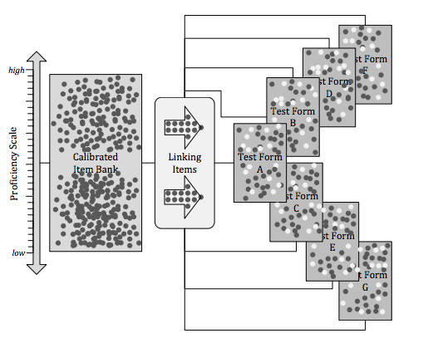
Pre-Equating Design (Anchored Calibrations)
Source: Luecht & Camara, 2011

Slide 45
IRT Test Linking in Large-Scale Assessments
Horizontal Equating
Different test forms within same grade and time of administration (here equivalent groups is a reasonable assumption)
Different tests within same grade across time periods (not necessarily equivalent groups anymore)
Vertical Scaling/Equating
Different tests across grades (though usually in same time period).

Slide 46
Why Use IRT over Observed Score Equating Methods?
If assumptions hold, then provides great flexibility in test form construction and maintenance.
Very easy (too easy?) to implement
Might argue that if IRT produces an interval scale (Rasch Model), then we no longer have to worry about discrete nature of variables being equated (as is the case in equipercentile methods)

Slide 47
Doing Separate IRT Equating in R
See “IRT Equating in mirt.html” (easy to update this with additional functions using something like Claude Code)
Another option…
Weeks, J. P. (2010) plink: An R package for linking mixed-format tests using IRT-based methods. Journal of Statistical Software, 35(12), 1–33. URL http://www.jstatsoft.org/v35/i12/

Slide 48
References
Kolen, M. & Brennan, R. (2004) Test Equating, Scaling, and Linking. Springer. https://link.springer.com/book/10.1007/978-1-4757-4310-4
Holland, P. & Dorans, N. (2006). Linking and Equating. In R. Brennan (ed) Educational Measurement, 4th Edition.

